Slide 1
Amazon Retail api

Slide 2

WHAT IS AMAZON RETAIL

Slide 3
OVERVIEW
Amazon retailer is an American electronic commerce company with headquarters in Seattle, Washington.
It is the largest Internet-based retailer in the United States.
It started as an online bookstore, but soon broaden its horizons, selling DVDs, VHSs, CDs, video and MP3 downloads/streaming, software, video games, electronics, apparel, furniture, food, toys, and jewelry.
Amazon retailer is a major provider of cloud computing services. They also sell certain low end products like USB cables under its in house brand Amazon Basics.

Slide 4
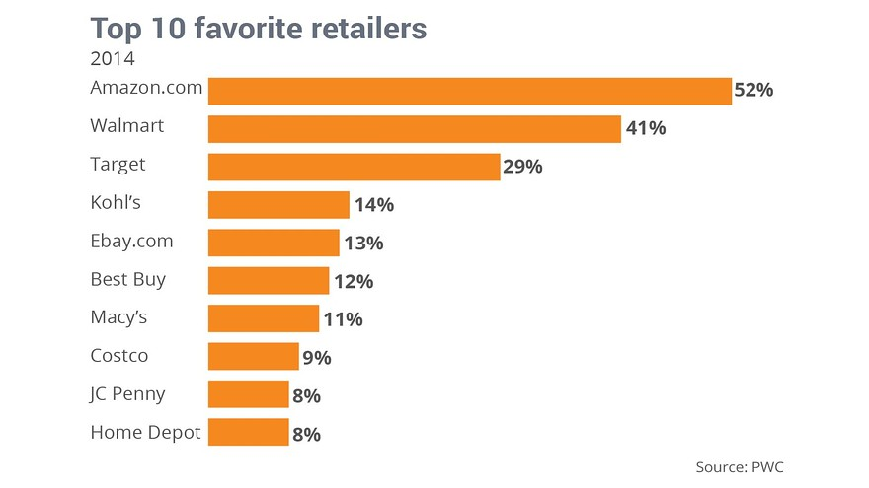
Amazon tops Wal-Mart as favorite consumer retailer

Slide 5
History of amazon
Amazon.com was founded by Jeff Bezos
Bezos left his employment as vice-president of D. E. Shaw & Co., a Wall Street firm, and moved to Seattle. He began to work on a business plan for what would eventually become Amazon.com.
This move was spurred by what Bezos called his "regret minimization framework"
Which described his efforts to fend off any regrets for not participating sooner in the Internet business boom during that time.
In 1994 Bezos incorporated the company as "Cadabra" he later changed the name to Amazon. In 1995 it went online as Amazon.com

Slide 6
History of amazon cont’d
Bezos changed the name cadabra to amazon because it sounded too much like cadaver.
Additionally, a name beginning with "A" was preferential due to the probability it would occur at the top of any list that was alphabetized.
Bezos selected the name Amazon by looking through the dictionary, and settled on "Amazon" because it was a place that was "exotic and different" just as he planned for his store to be
the Amazon river, he noted was by far the "biggest" river in the world (according to drainage, not length), and he planned to make his store the biggest in the world

Slide 7
Amazon WEB SERVICES
Amazon Web Services provides Amazon’s developer customers with access to in-the-cloud infrastructure services based on Amazon’s own back-end technology platform, which developers can use to enable virtually any type of business.

Slide 8
History of API
The concept of an API pre-dates even the advent of personal computing, let alone the Web, by a very long time! The principal of a well documented set of publicly addressable "entry points" that allow an application to interact with another system has been an essential part of software development since the earliest days of utility data processing

Slide 9
Product Advertising API
Provides programmatic access to Amazon’s product selection and discovery functionality
Developers can advertise Amazon products to monetize their website.
The Product Advertising API helps you advertise Amazon products
It uses product search and look up capability, product information and features, Similar Products, Wish Lists and New and Used listings.

Slide 10
Product Advertising API CONT’D
You can make money using the Product Advertising API to advertise Amazon products in conjunction with the Amazon Associates program.
When you join the Amazon Associates program you can earn up to 8.5% in referral fees when the users you refer to Amazon sites buy qualifying products.
The Product Advertising API gives you access to Amazon’s selection of millions of products.
It uses categories such as books, music, digital downloads and electronics from Amazon.com, Amazon.ca, Amazon.co.uk, Amazon.de, Amazon.fr, and Amazon.co.jp.

Slide 11
Leverage Amazon Product Discovery capabilities
The Product Advertising API lets you leverage Amazon’s customer-centric features such as Product Search, Customer Reviews, Similar Products, Accessories, Listmania Lists and more.

Slide 12
Monetize your website
The Product Advertising API allows you to include your associate tag in API requests to automatically format the URLs returned by the API to ensure that you earn referral fees when users you refer to Amazon sites buy qualifying products.

Slide 13
Detailed Description
How do you want to advertise Amazon products? The Product Advertising API has the features you need to advertise Amazon’s huge selection of products. You can Advertise a product, Let your users search for Amazon products and Help your users discover Amazon products.

Slide 14
Advertise a product
Do you already know which Amazon product to advertise? Use ItemLookup requests to get product titles, links back to Amazon, image urls and prices for new, used and collectible listings on Amazon, Customer Reviews, Accessories, Similar Products and more.

Slide 15
Customer Reviews API
Retrieving Customer Reviews
This example uses the ItemLookup operation in conjunction with the Reviews response group to retrieve the customer reviews data for a particular item, ASIN B004HFS6Z0 (Kindle Wi-Fi).
Example Request
http://webservices.amazon.com/onca/xml? Service=AWSECommerceService &Operation=ItemLookup &ResponseGroup=Reviews &IdType=ASIN &ItemId=B004HFS6Z0 &AssociateTag=[Your_Associate_Tag] &AWSAccessKeyId=[Your_AWSAccessKeyId] &Timestamp=[YYYY-MM-DDThh:mm:ssZ] &Signature=[Request_Signature]
Example Response
<Item> <ASIN>B004HFS6Z0</ASIN> <CustomerReviews> <IFrameURL> http://www.amazon.com/reviews/iframe? akid=[Your_AWSAccessKeyId] &alinkCode=xm2 &asin=B004HFS6Z0 &atag=[Your_AssociateTag] &exp=2011-06-01T22%3A32%3A53Z &v=2 &sig=pxn6bbln%2B%2FVTPJdj8oCcXvjTHmo3spkUMjbQMPbhCKI%3D </IFrameURL> <HasReviews>true</HasReviews> </CustomerReviews> </Item>

Slide 16
Let your users search for Amazon products
Help your users find the Amazon products they are looking for by using ItemSearch requests to get results sorted by relevance, sales rank or price and grouped into user-selected bins.

Slide 17
Help your users discover Amazon products
Advertise Top Sellers, New Releases, Most Wished for and Most Gifted Amazon products or remind your users about their Wish Lists. Help them use Listmania lists created by other Amazon customers to find what they need.

Slide 18
Login and Pay with Amazon
No need for customer to create new accounts on your site
Trusted by over 200 million current amazon account holders
Fewer clicks from the beginning to the end of transaction
Enables customers to stay on your site throughout the payment process
You are able to control the customer experience with your brand from start to finish

Slide 19



Login and Pay with Amazon
Offering a trusted payment experience encourages shoppers to buy again
By enabling customers to buy with any web enabled phone or tablet you can capitalize on mobile shopping movement
No worries on reliability. Built on Amazon's world class ecommerce infrastructure
You only pay when a customer buys on your site

Slide 20
Cart Creation
The first time a customer wants to add an item to their shopping cart, a remote shopping cart must be created, which is accomplished using the CartCreate operation. It is not possible to create an empty cart. At least, one item must be added.
Modifying a Cart
If a customer has an existing remote shopping cart, it should be used and modified accordingly. Modification can come in many forms:
Items can be added to and deleted from the cart
Items can be moved from the Active area of the cart to the SaveForLater area, or the reverse
The CartId and HMAC are used in the CartModify, CartAdd, or CartClear operations to modify the contents of the cart.

Slide 21
Cart Creation
Cart Expiration
It is not possible to delete a remote shopping cart. Instead, it expires automatically after ninety days of disuse if there are items in the cart, or, if the cart is empty, after seven days of disuse.
Carts are emptied either by the CartClear orCartModify operations, or automatically when the customer purchases the items in their cart.
The expiration of the cart is reset when the cart is modified. For example, if, on day eighty-nine of disuse, a customer modifies the items in their shopping cart, the life time of the cart is reset to an additional ninety days. In that way, shopping carts can last indefinitely.
Once the items in a cart have been purchased using the PurchaseURL value, the cart is not deleted immediately but it should no longer be used.
From a customer's point of view, once he or she has purchased the items in their cart and there are no items remaining in the SaveForLater section, the old cart is gone. The next time they want to purchase an item, they receive a new cart.

Slide 22
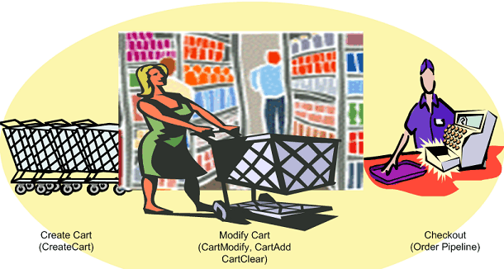
Cart Lifespan
Shopping carts have a lifespan. A remote shopping cart is created and, in time, it expires. In between, the contents of the cart can be modified and purchased, as shown in the above diagram.

Slide 23
Amazon in house prodUcts
Amazon Kindle(2007)
Originally released with black & white display known E-Ink
Download books in less than 60 seconds with built-in Wi-Fi
Battery lasts weeks, not hours
Access to over 80,000 Books on Amazon.com on release
As of February 2015 over 3.2 million Books on the Kindle Store
Kindle Fire tablets(2011)
Android base tablet with a starting price of $199
7-inch IPS color touchscreen display
This was the first kindle without an E-Ink display
Successors Kindle Fire HD was released in 2012 & Kindle Fire HDX released in 2013

Slide 24
Amazon in house prodUcts
Amazon Fire TV (2014)
Supports a Wide Array of Apps
Also a Gaming Console
Stream Full HD
Amazon Fire Phone (July 2014)
Videos can be downloaded, or pre-buffered
Free unlimited cloud storage for photos -- and Amazon content
Backup automatically, or not at all
In October 2014 Amazon stated that they took a $170 million hit
They had over $83 million worth of Fire Phones in inventory
.

Slide 25
SERVICES FOR GAME DEVELOPERS
Amazon provides game developers a wide range of tools and services to help them build, distribute, scale, optimize and monetize their games.
The services are designed to help developers move more quickly, reach new customers, and sell more content.
With In-App Purchasing, you can sell digital content—such as in-game currency, expansion packs, upgrades, and more

Slide 26
Amazon APP STORE
The Amazon Appstore allows developers to distribute and sell their Android and HTML5 web apps to millions of customers in nearly 200 countries around the world.
Developers are paid 70% of the list price of app or in-app purchase
One of the promotional tool Amazon app store uses is “Free app of the Day”, in which a different free app is offered every day.
The app store has a feature known as “Test Drive” which allows users to try an application in their web browser by launching a virtual cop of Android in the Amazons EC2 cloud for 30 mins.

Slide 27
Amazon APP STORE CONT’d
The Amazon Mobile App SDK provides APIs, tools, and resources to take advantage of these features. APIs such as Amazon In-App Purchasing, Mobile Ads, Mobile Associates and GameCircle help developers monetize their apps and games and engage their customers.
The In-App Purchasing (IAP) API makes it easy for you to offer digital content and subscriptions for purchase within your app, such as in-game currency, expansion packs, upgrades, magazine issues, consumables
The Amazon Mobile Ads API is an in-app display advertising solution to monetize mobile apps and games across platforms, including phones and tablets on Android, iOS, and Fire

Slide 28
In App Purchasing api calls
ResponseReceiver
In-App Purchasing API performs all of its activities in an asynchronous manner. Your app needs to receive broadcast intents from the the Amazon Appstore via the ResponseReceiver class. This class is never used directly in your app, but for your app to receive intents, you must add an entry for the ResponseReceiver to your AndroidManifest.xml file. The following code snippet shows how to add a ResponseReceiver to the AndroidManifest.xml file for IAP v2.0:
<application>
...
<receiver android:name = "com.amazon.device.iap.ResponseReceiver" >
<intent-filter>
<action android:name = "com.amazon.inapp.purchasing.NOTIFY"
android:permission = "com.amazon.inapp.purchasing.Permission.NOTIFY" />
</intent-filter>
</receiver>
...
</application>

Slide 29
AMAZON PRIME AIR
A future delivery system from Amazon designed to safely get packages into customers’ hands in 30 mins or less via drones
Prime Air vehicles will be as normal as seeing mail trucks on the road.
Prime Air service will be deployed when Amazon has the regulatory support needed to realize there vision.
Safety a top priority and vehicles will be built with multiple safety mechanisms

Slide 30
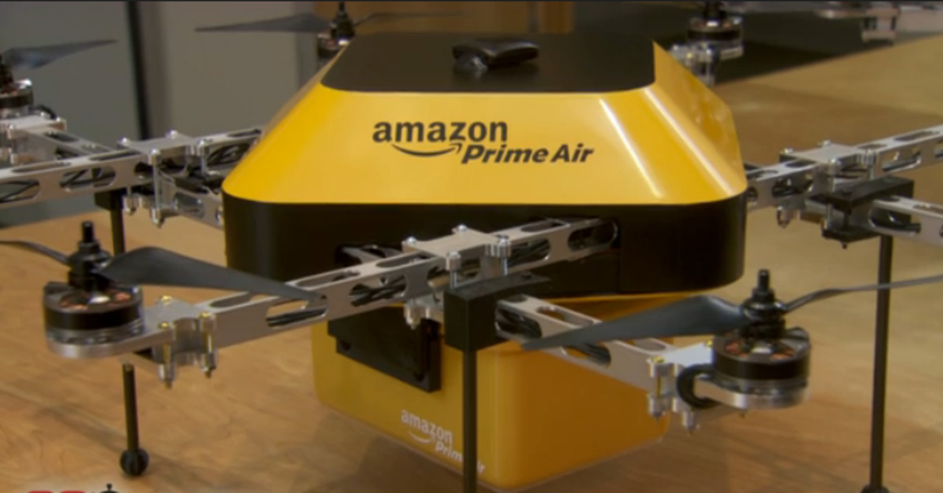
AMAZON PRIME AIR
EARLY PROTOTYPE

